Slide 1


Immigrants, Refugees, and Canadian Churches

Slide 2


Welcome!
These slides are based on a recently developed Guide to Action
The Guide to Action was developed from findings of a national research project entitled ‘The Role of Churches in Immigrant Settlement and Integration’ (see slide 24)
The Guide to Action provides strategies (called ‘Wayfinding Actions’) that we, as Church leaders, can use as we work with – and learn from – immigrants and refugees.

Slide 3

Finding Our Way
The Guide to Action seeks to answer four main questions:
Where are we?
Why should we get involved?
What could we do?
How can we learn from each other?

Slide 4
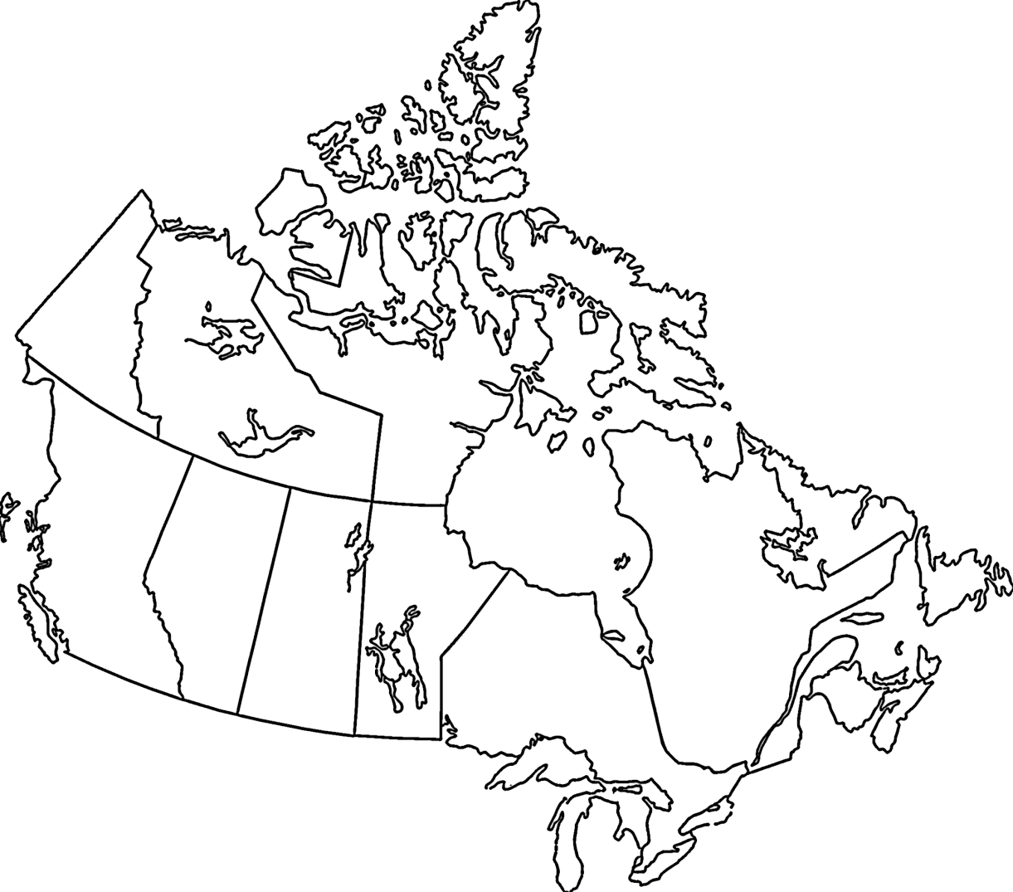
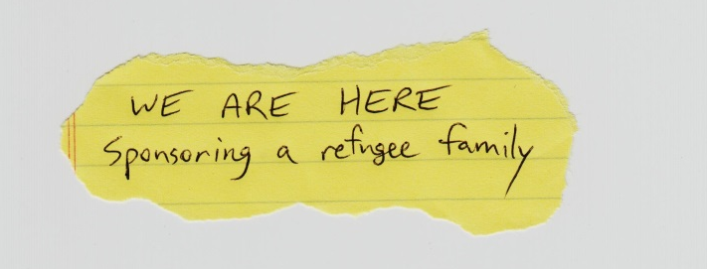
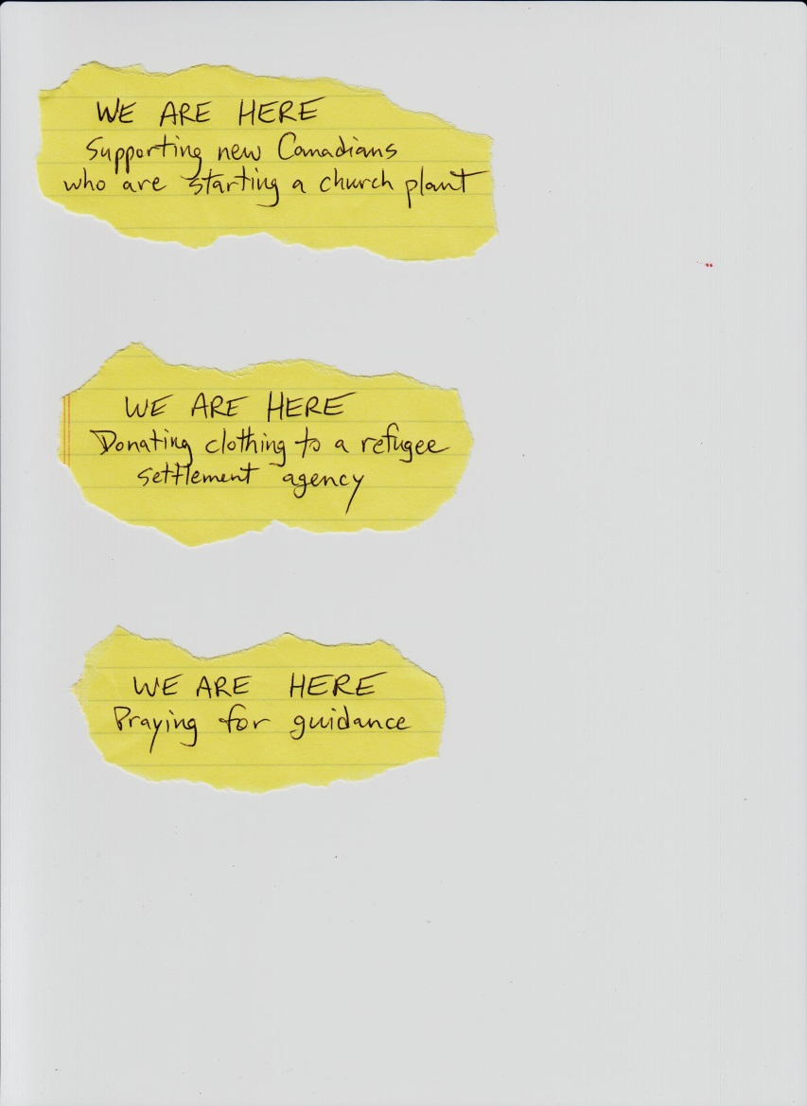
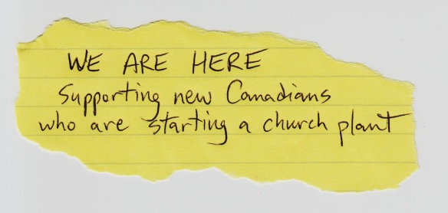

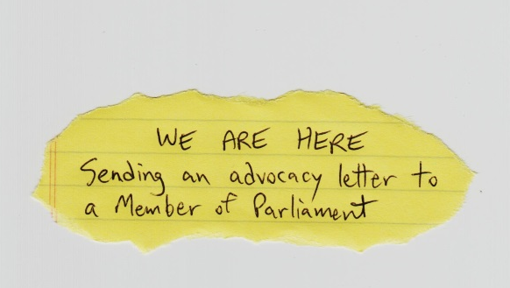
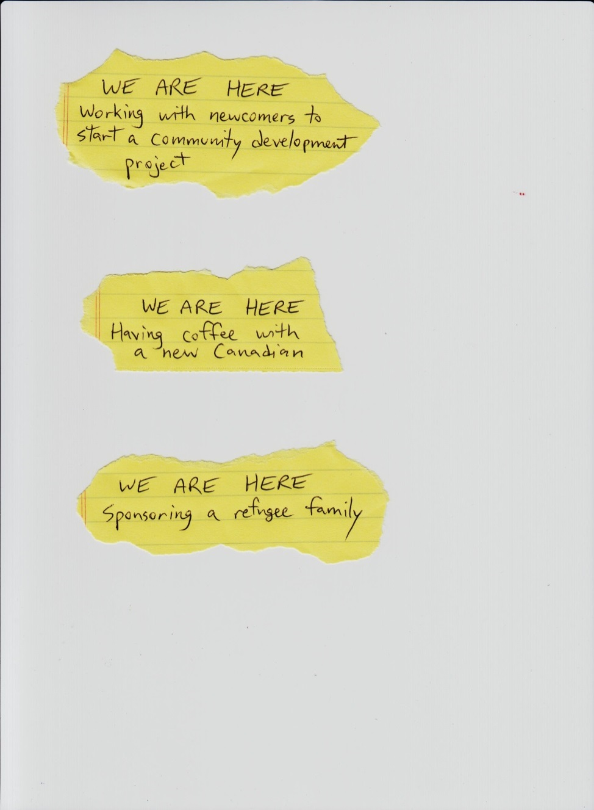


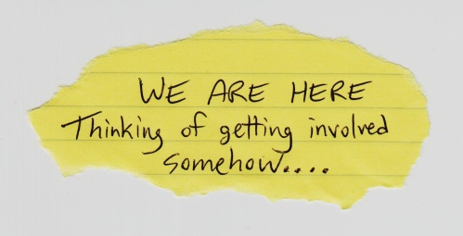
Section One:
Where Are We?

Slide 5

Where Are We?
Churches are at different places and stages, doing different things
As people move closer to God,
they move closer to each other
How we relate to and approach one
another becomes an expression of how
we relate to and approach God
So, to answer “Where are we?” we might say “We are on our way toward God, and we are on our way to becoming closer with other people”
Take time to reflect: Where are you? What is your church currently doing with immigrants and refugees?

Slide 6
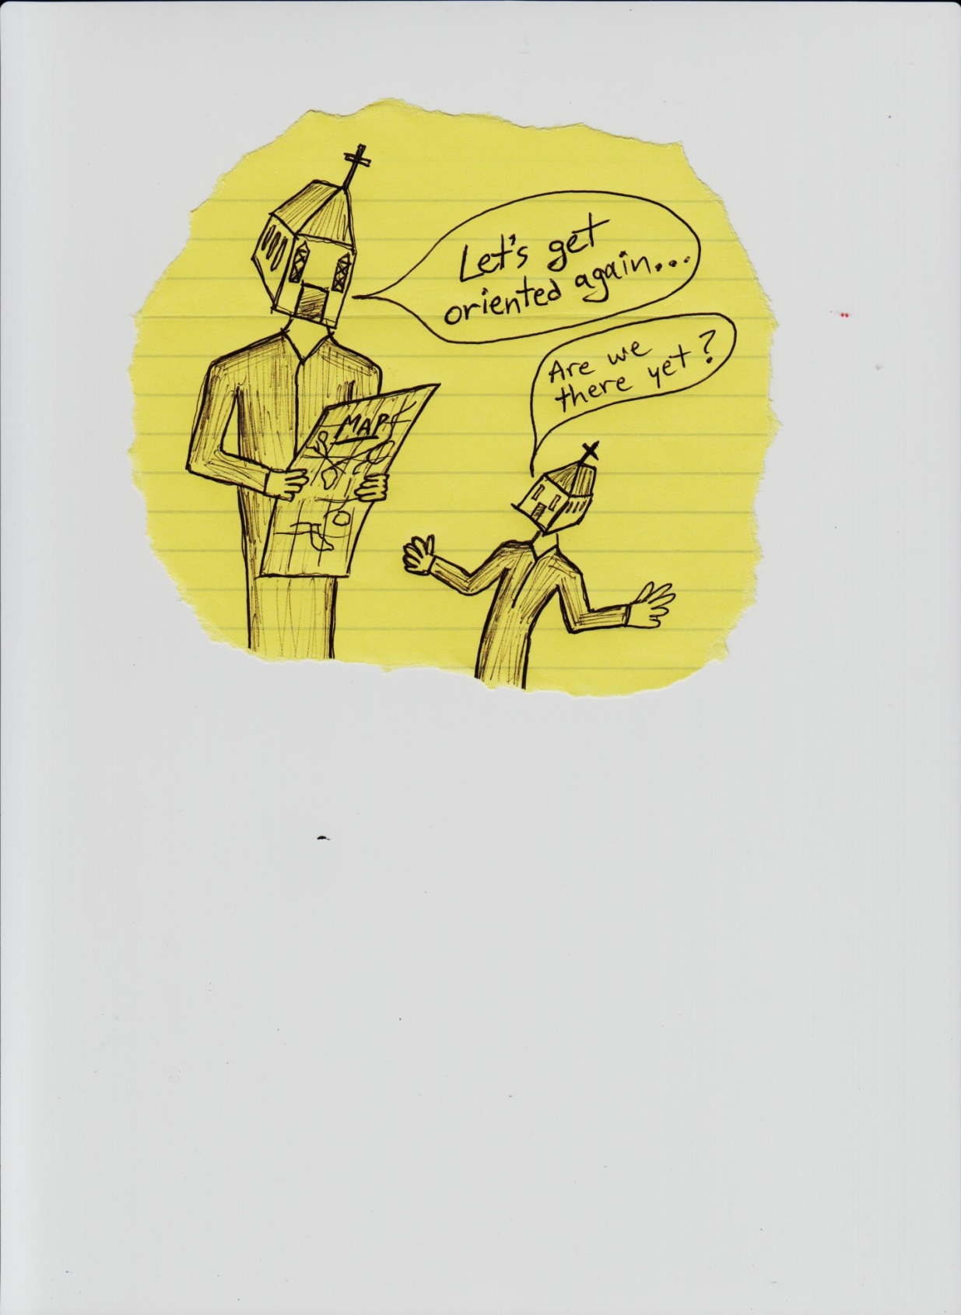
WAYFINDING ACTION:
Re-Orient Yourselves
Convene members of your church and create discussion using maps
    Display a map of your community and talk about cultural or religious diversity in the area
    Display a map of the Refugee Highway, and talk about the underlying causes of displacement
This exercise can…
    Provide a sense of renewed purpose
    Inform your ministry of new insights
    or recent statistics
    Help chart a course into the future

Slide 7
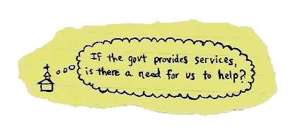



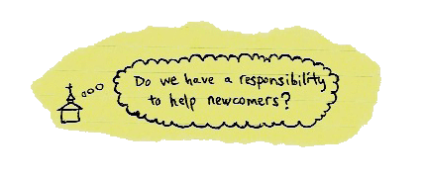
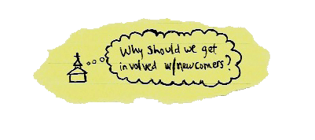
Section Two:
Why Should We Get Involved?

Slide 8
Why Should We Get Involved?
The immigrant population is growing and diversifying
Today, 20% of people in Canada are foreign-born
By 2031, the number of foreign-born will increase to 30%
Vision is the motivation that provides direction for us as churches to get involved in supporting immigrant settlement and integration
Two MAJOR motivating factors:
    A biblical/theological mandate to “Welcome the Stranger”
    A desire to connect to people’s common humanity

Slide 9
WAYFINDING ACTION:
Write a Formal Statement
Oftentimes, formal statements encourage churches to move forward in their work with newcomers
Here are some ideas to help you write:
  Create a diverse team to lead in this process, but work to involve everyone, including newcomers
  Use prayer to discern how & where God is leading your church
  Look at the needs of the newcomers you will serve. Use these needs in the vision statement
  Use scripture as the Biblical mandate
  Don’t re-create the wheel. Rather, expand on your current vision or mission statement

Slide 10
WAYFINDING ACTION:
Organize a Book or Bible Study
A Book or Bible study can help to cast vision for working with immigrants and refugees
Here are some tips:
    Capitalize on your location (e.g., host in a local university or college)
    Use a Bible study that highlights God’s love for diversity and culture
    Use resources from organizations that cater specifically to newcomers
    Encourage newcomers to suggest books for your group to study
    Two suggested books for study: Conspiracy of Kindness (Steve Sjogren) and Strangers Next Door (J.D. Payne)

Slide 11
WAYFINDING ACTION:
Visit Another Church or Community Agency
Some of the best ideas for working with newcomers come from church leaders sharing and constructively critiquing the work that each is doing
Here are some ways to get started:
    Volunteer at a community agency
    Ask local community agencies for the names of churches who regularly help out
    Network with other church leaders you already know, including church leaders who are immigrants themselves

Slide 12
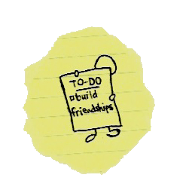

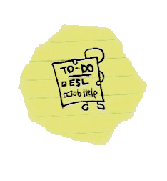
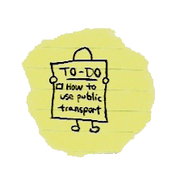

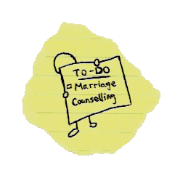
Section Three:
What Could We Do?
“There’s lots of ways churches can be involved, but that’s the thing… to be involved”
(Church leader)

Slide 13
What Could We Do?
What we do is directly connected to why we are doing it
There are three broad types of support that we tend to provide:
  Informal Support
    Friendships and personal relationships
  Formal Programs
    Addressing immediate settlement needs
    Advocating for immigrants and refugees
    Assisting with longer-term integration needs
  Support through Partnerships
    Our churches do not have the expertise for all things

Slide 14
WAYFINDING ACTION:
Invite Newcomers to Dinner
There is immense relational value in offering food and hospitality to newcomers
Initiate a relationship by inviting newcomers for dinner
Informally “sponsor” an international student, by sharing meals throughout the week
Over food, listen to newcomers’ stories, and share yours
“I think the church can do something that nobody else can do, and that’s providing accompaniment, providing that sense of community, of friendship, which community agencies have a really difficult time doing.” (Church Leader)

Slide 15
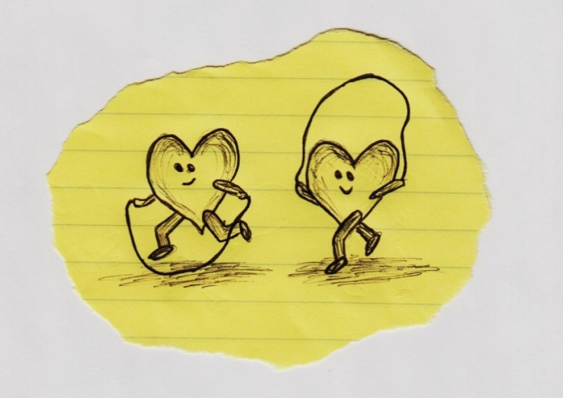
WAYFINDING ACTION:
Create your own program
Programs are a type of formal support that your church can provide
In creating a program, think about…
      the relationships your church has made with recent immigrants and refugees
      the re-occurring practical ways that you have supported newcomers
      the resources your congregation possesses in order to meet those needs in an ongoing way (human, financial, etc.)
Talk with recent immigrants & refugees
in your congregation for insight
Talk with neighboring churches
and community organizations

Slide 16
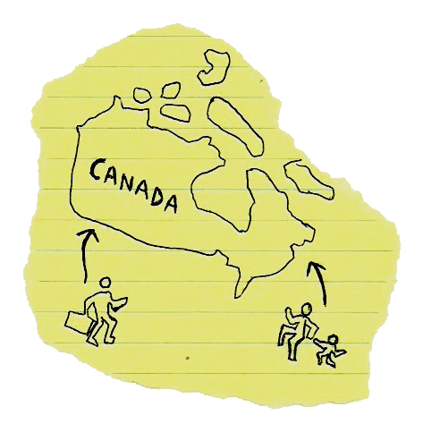
WAYFINDING ACTION:
Sponsor a Refugee Family
Canadian churches have been involved with refugee settlement for a very long time
Connect with people’s common humanity, leading the way to share God’s heart of love and compassion for the marginalized and oppressed
Form partnerships with civic
& non-civic organizations
Seek other churches who are
currently sponsoring refugees

Slide 17
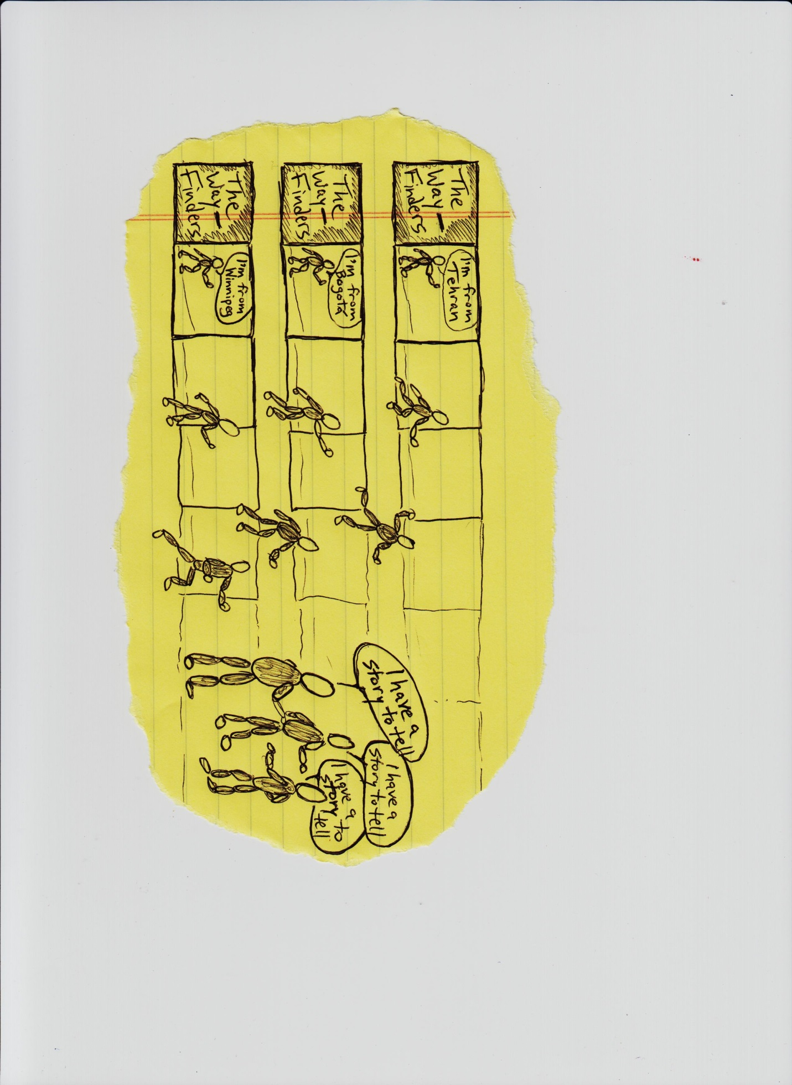
Section Four:
How Can We Learn From Each Other?

Slide 18
How Can We Learn From Each Other?
… by listening to each other and discovering things about each other
… by building relationships with people from other cultures, other faiths, and other traditions
… by letting those relationships steer the development of our programs

Slide 19
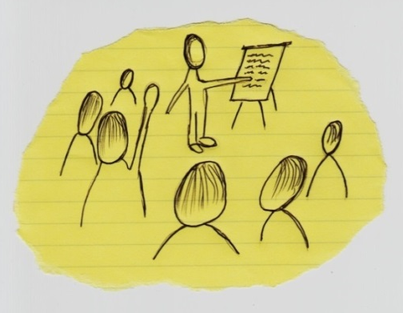
WAYFINDING ACTION:
Host an Intercultural Workshop
Through intercultural workshops, we can:
  Learn about our various cultural backgrounds, traditions, and assumptions
  Explore our cultural differences and similarities
  Gain vocabulary to talk about cultural differences
  Work together to analyze and even change intercultural dynamics in our interpersonal relationships and communities
  Learn about ‘cultural sensitivity’ and
  ‘cross-cultural competency’
Consider bringing in an outside
facilitator or lead the workshop
yourselves.

Slide 20
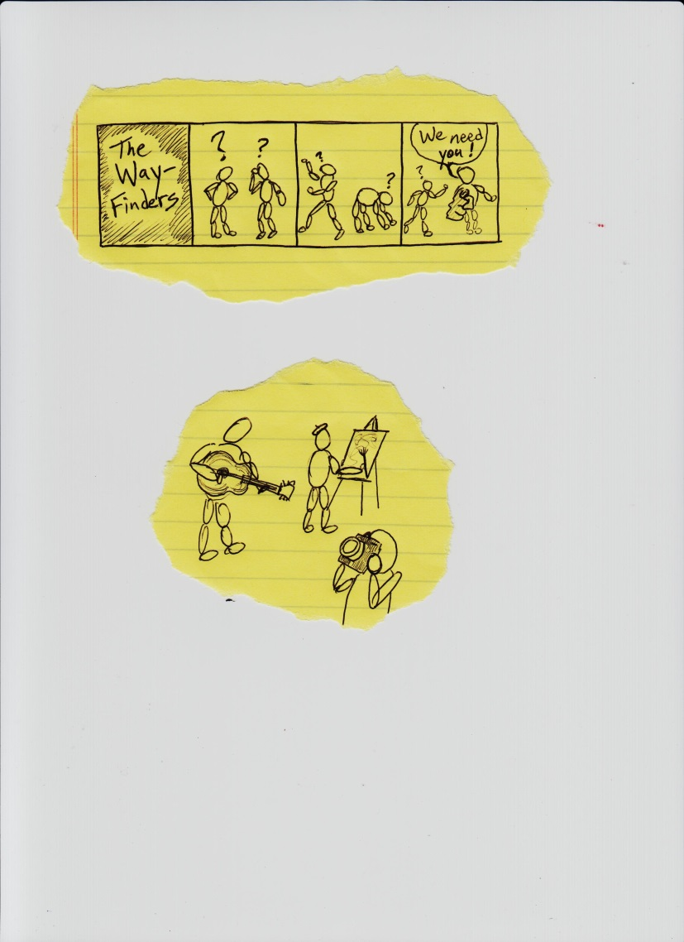
WAYFINDING ACTION:
Initiate a Community Arts Project
Use artistic expression as a way of empowering people, telling stories, learning about underlying social/political issues, or nurturing community
Art can be used by people to express their histories, their journeys, their struggles, and their hopes in multiple forms
    Photography
    Drama
    Music
    Visual Arts

Slide 21

WAYFINDING ACTION:
Consider Offering Sanctuary
Sanctuary is the act of offering a safe place for a refugee who is facing deportation
Offering sanctuary can be controversial
Offering sanctuary can provide a unique opportunity for the church community to build relationships with refugees and with a variety of other governmental and nongovernmental organizations
Offering sanctuary involves significant
financial and logistical commitments, as
well as legal issues for which ongoing legal
counsel may be required

Slide 22
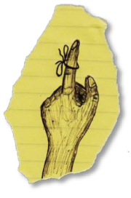
WAYFINDING ACTION:
Tie a String Around Your Finger
Remind yourself of why you are
doing what you are doing
Remind yourself of the Biblical
passage that got you involved
initially
Explore creative ways to remind others in your church community about the importance of working with immigrants and refugees
  Make banners for your church sanctuary
  Use social media to generate regular reminders about ministry projects or to organize a virtual rally

Slide 23
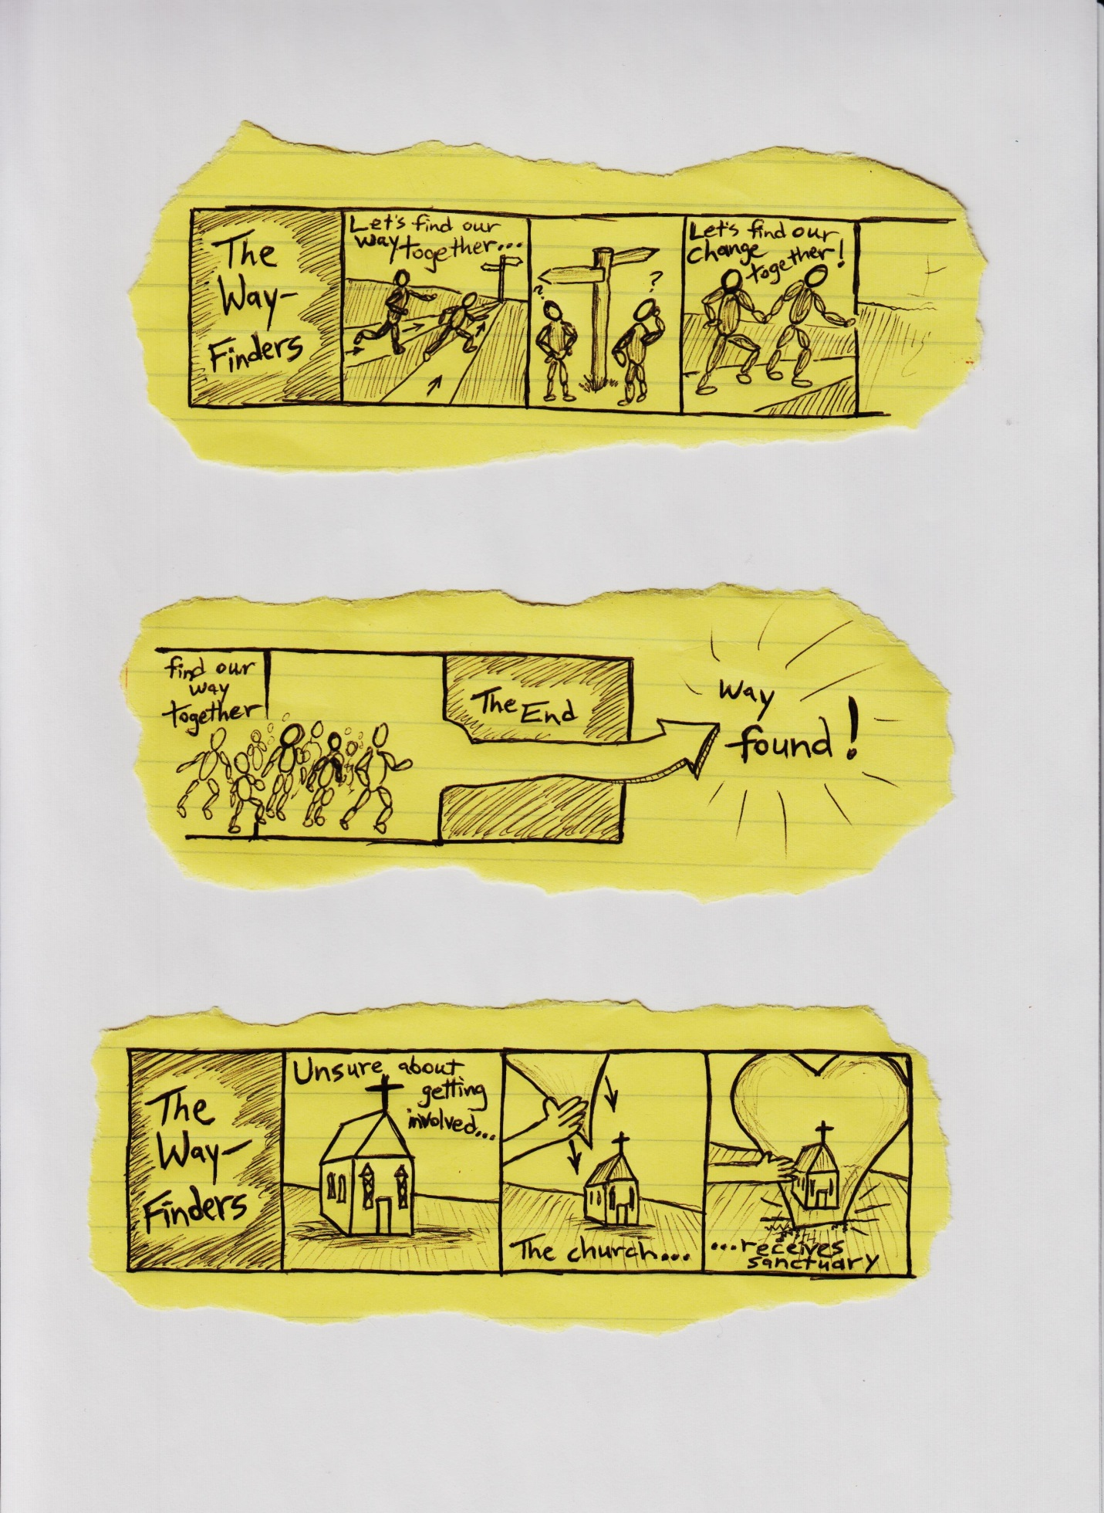
Where Do We Go From Here?
The ‘Wayfinding Actions’ explored in these slides represent a small fraction of the many kinds of actions that will be initiated by Canadian churches moving forward
Wherever you find yourself, understand that something very momentous lies ahead.
“For surely I know the plans I have for you, says the LORD, plans for your welfare and not for harm, to give you a future with hope” (Jeremiah 29:11)

Slide 24
About the Project
Led by the Centre For Community Based Research (Kitchener, ON)
Funded by the Social Sciences and Humanities Research Council of Canada (SSHRC)
For a copy of the Guide to Action, click here: http://www.communitybasedresearch.ca/Page/View/Guide_to_Action
For more information about the
project and a full list of partners, visit:
http://www.communitybasedresearch.ca/Page/View/PDG
For access to all research reports, visit: http://www.communitybasedresearch.ca/Page/View/Churches_and_Immigrants_Reports

