Slide 1
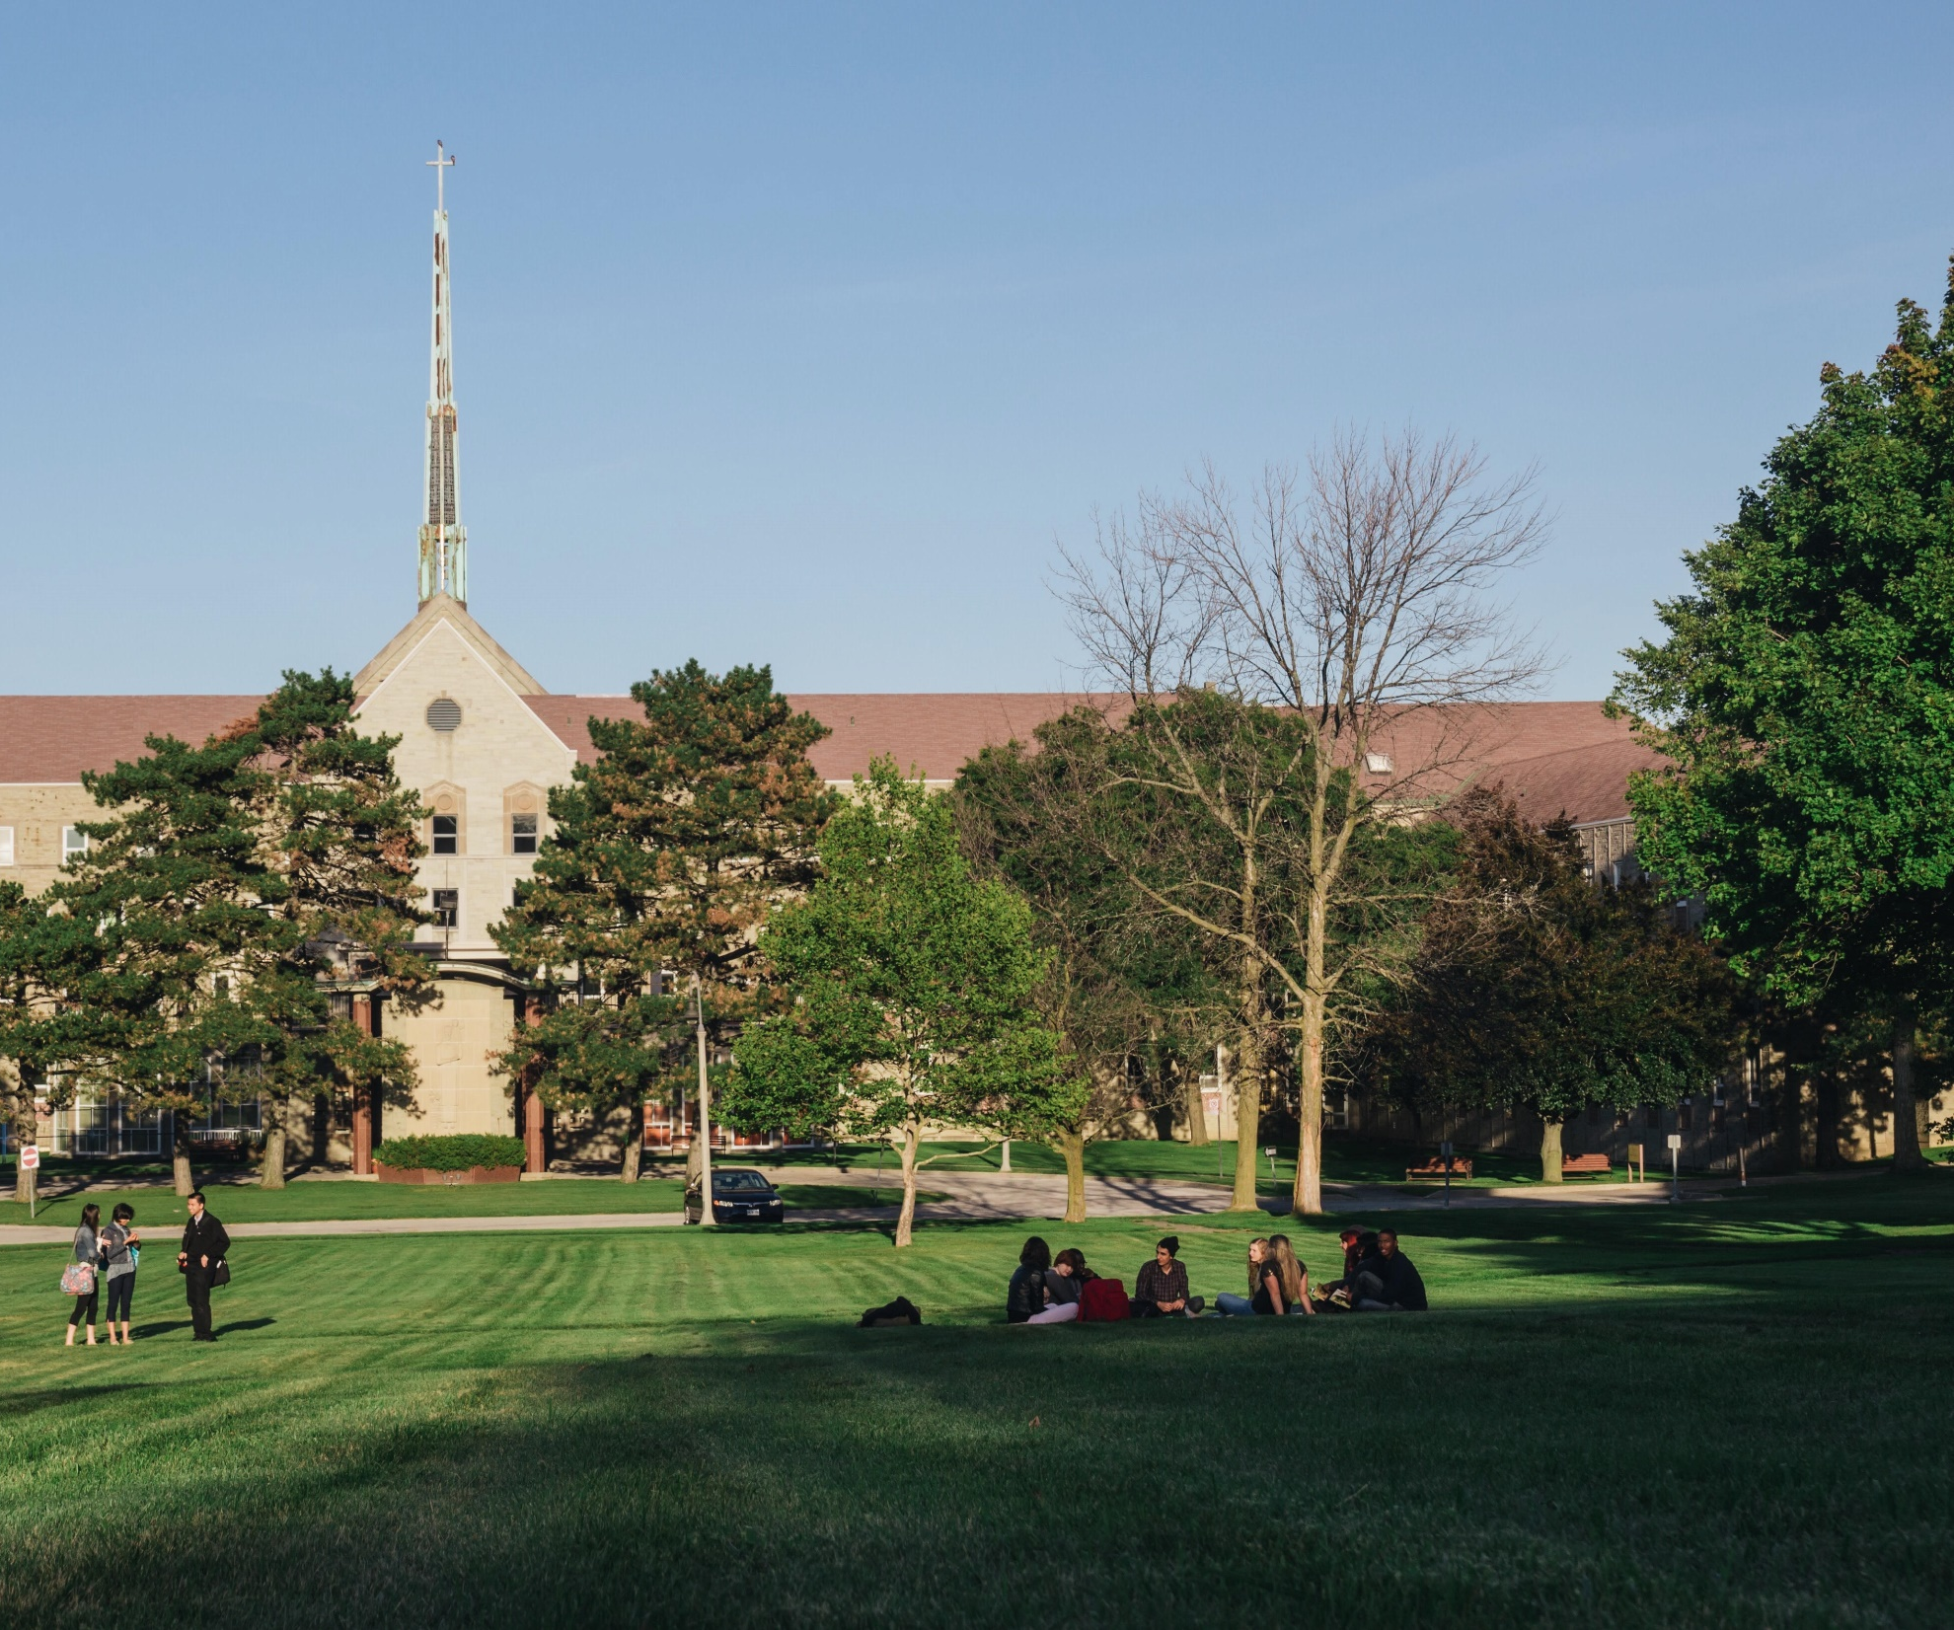

TITLE
SUB TITLE
PRESENTER
tyndale.ca

Slide 2
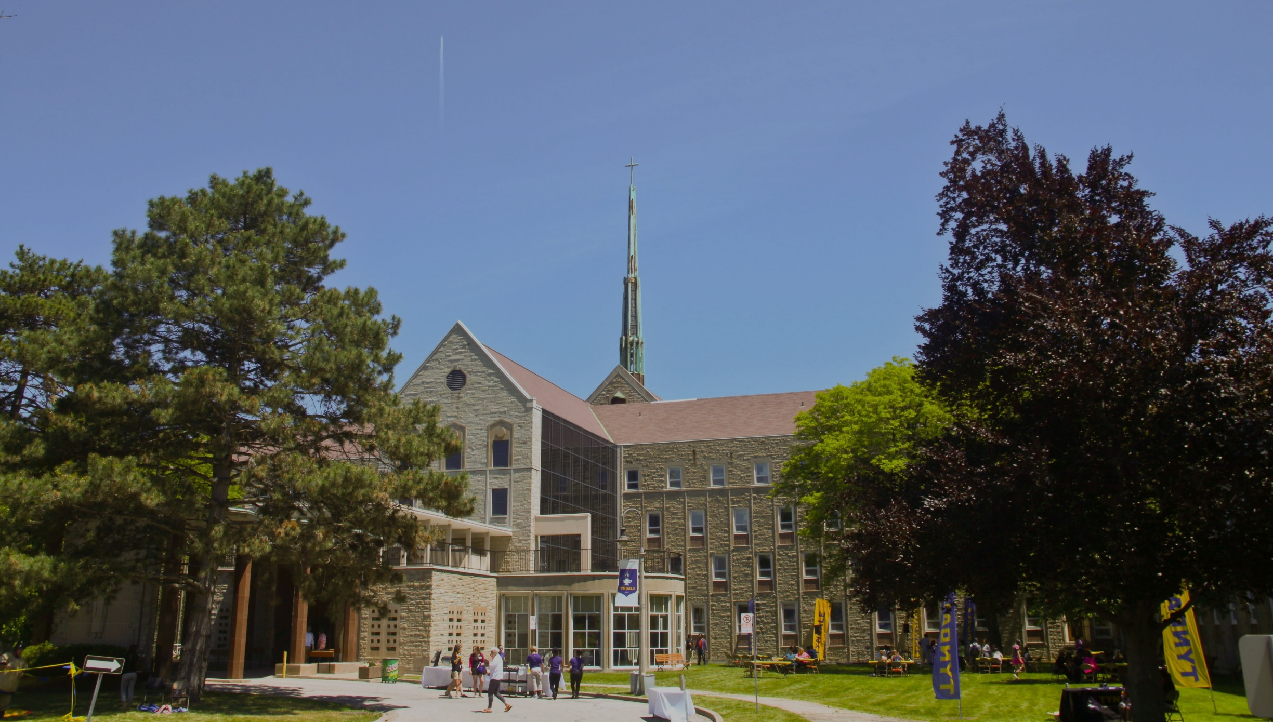
ww
[SUBJECT] | TYNDALE UNIVERSITY

Slide 3
Tyndale is dedicated to the pursuit of truth, to excellence in teaching, learning and research, to the development of mind, heart and character, to serve the church and the world for the glory of God.

Slide 4
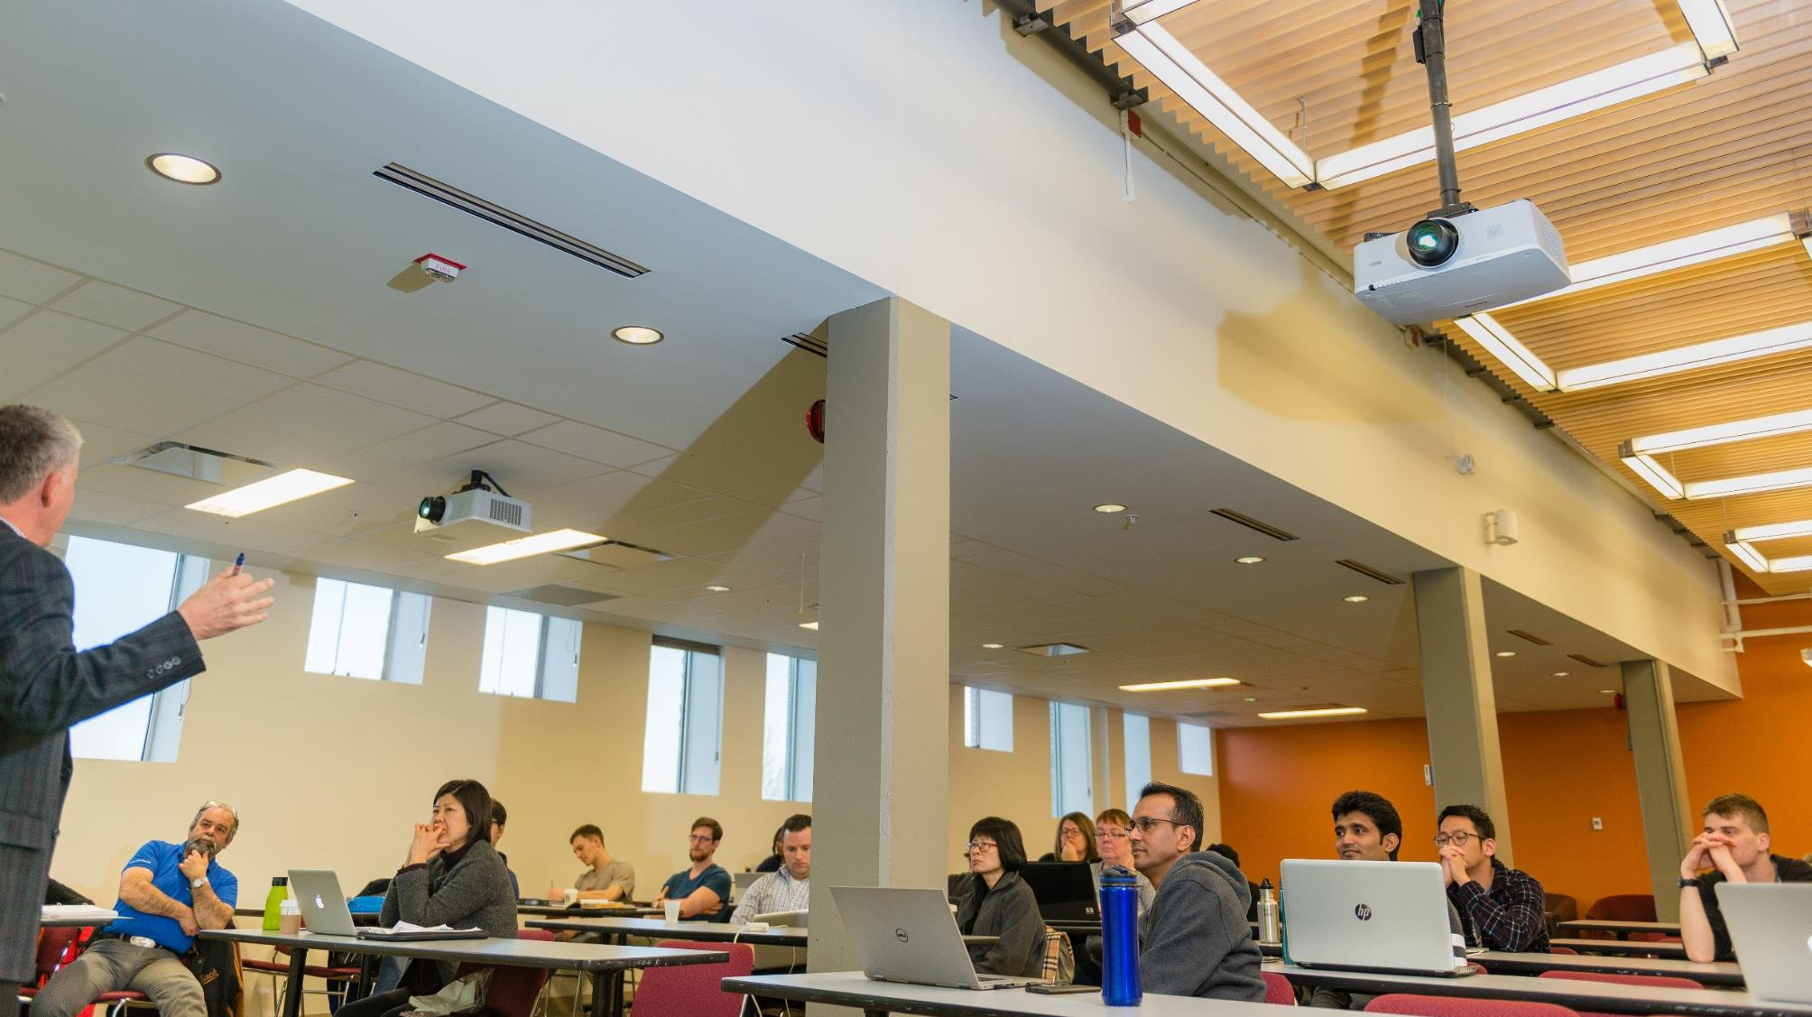
ADD TITLE OF SLIDE
Graduate Diploma: one-year program (9 courses)
Master of Theological Studies:
two-year program (18 courses)
Master of Divinity: three-year program (27 courses)
Doctor of Ministry (DMin)
Masters of Theology (ThM)

Slide 5
A/The book of the beginning of Jesus Christ [Βίβλος γενέσεως Ἰησοῦ Χριστοῦ], son of David, son of Abraham
  βίβλος : Note – a book not list of sayings
    NIV84: ‘A record’; NIV2011: ‘This is a genealogy’ [fn. ‘an account of the origin’]; NLT96: ‘This is a record’; NRSV ‘an account’
  γένεσις: translated different ways
    NIV: genealogy; ESV: genealogy;
    LXX Genesis 5:1 – αὕτη ἡ βίβλος γενέσεως ἀνθρώπων (‘This is the book of the generations of humanity/Adam[?])
    Hauerwas: a beginning of a new age in Jesus
  Christ/Messiah
  Son of David
  Son of Abraham (note the reversed order)
PAGE # | TYNDALE UNIVERSITY

Slide 8
QUESTIONS?
CONTACT NAME
Telephone/voice mail: (416) 226-6620 Ext. XXX
Email: name@tyndale.ca
Office Hours: Tuesdays 5:15PM - 6:00PM or
Book another time by appointment.

Slide 9


